Slide 1


Slide 2
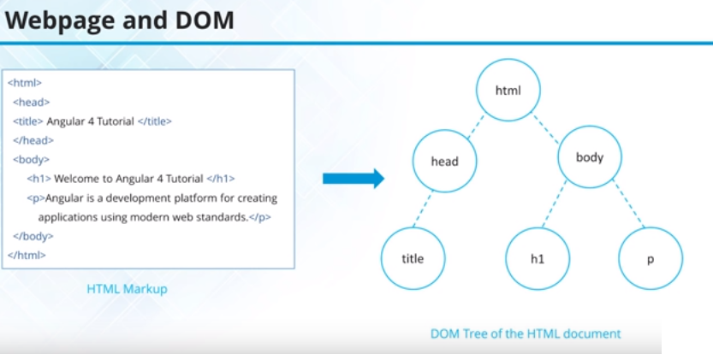

Slide 3
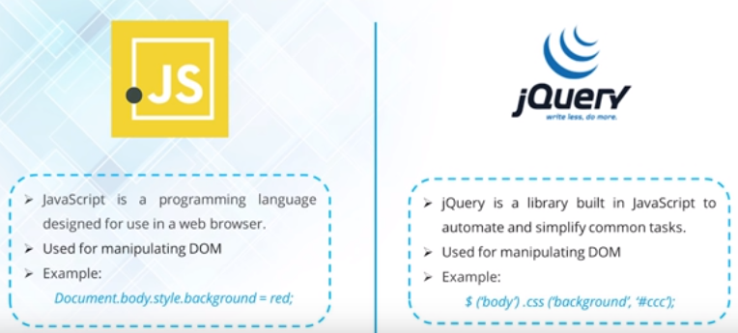

Slide 4
Angular 1 was released in October 2010, and by far the most popular JavaScript framework available for creating web applications. Many developers are already using Angular 1, so the obvious question that comes to our mind is why should we use Angular 2. Angular 2 is not a simple upgrade from angular 1. Angular 2 is completely rewritten, so it has lot of improvements when compared with Angular 1. Let's look at a few of these improvements.
Performance : From a performance standpoint, Angular 2 has faster initial loads, change detection, and improved rendering time. Not just performance, we also have improved modularity, Dependency injection and testability. According to angular conference meetup, Angular 2 is 5 times faster compared to AngularJS 1
Mobile Support : Angular 1 was not built for mobile devices. It is possible to run Angular 1 on mobile but we will have to use other frameworks. Angular 2 on the other hand is designed from the ground up with mobile support. Mobile device features and limitations like touch interfaces, limited screen real estate, and mobile hardware have all been considered in Angular 2. So with Angular 2 we can build a single application that works across mobile and desktop devices. Component Based Development : Component based web development is the future of web development. In Angular 2, "everything is a component". Components are the building blocks of an Angular application. The advantage of the component-based approach is that, it facilitates greater code reuse. From unit testing standpoint, the use of components make Angular2 more testable.

Slide 5
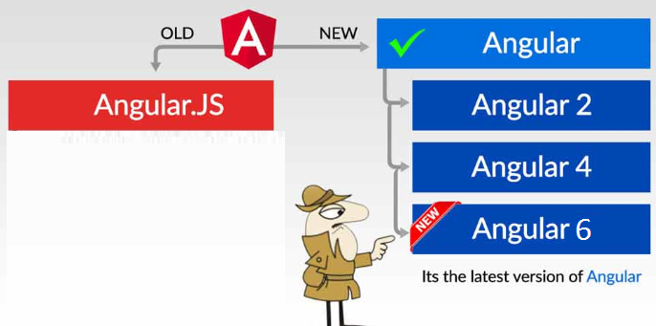
Angular JS
JavaScript framework for creating web and mobile single page applications.
AngularJS is an open-source, JavaScript-based, front-end web application framework for dynamic web app development. It utilizes HTML as a template language. By extending HTML attributes with directives and binding data to HTML with expressions, AngularJS creates an environment that is readable, extraordinarily expressive and quick to develop.
Angular
Angular is the blanket term used to refer to Angular 2, Angular 4 & 6 and all other versions that come after AngularJS. Both Angular 2,4,5 and 6 are open-source, TypeScript-based front-end web application platforms.

Slide 6
AngularJS
The architecture of AngularJS is based on model-view-controller (MVC) design. The model is the central component that expresses the application's behavior and manages its data, logic, and rules. The view generates an output based on the information in the model. The controller accepts input, converts it into commands and sends the commands to the model and the view.
AngularJS is written in JavaScript
Angular
In Angular , controllers and $scope were replaced by components and directives. Components are directives with a template.
Disadvantages of AngularJS
Not secure : Being JavaScript only framework, application written in AngularJS are not safe. Server side authentication and authorization is must to keep an application secure.
Not degradable: If the user of your application disables JavaScript, then nothing would be visible, except the basic page.

Slide 7
More language choices : There are several languages that we can use to develop Angular applications. To name a few, we have 1. ECMAScript 5 2. ECMAScript 6 (also called ES 2015) 3. TypeScript etc. Besides these 3 languages we can also use Dart, PureScript, Elm, etc, but among all these, TypeScript is the most popular language. Angular itself, is built using TypeScript. TypeScript has great support of ECMAScript 6 standard. So the obvious questions that come to our mind at this point are 1. What is ECMAScript 2. What is Type Script
What is ECMAScript : The JavaScript language standard is officially called ECMAScript. Over the past several years many versions of ECMAScript were released starting with ECMAScript version 1 all the way till ECMAScript version 7.

Slide 8
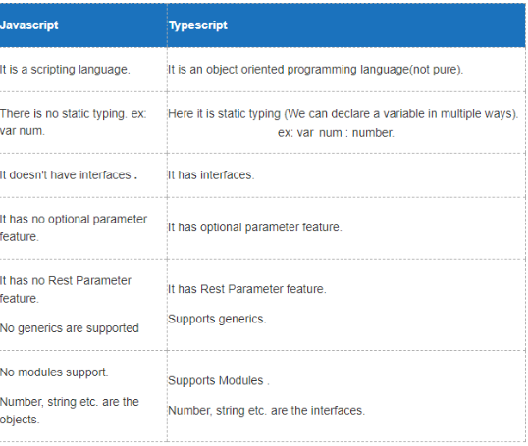
Difference between Typescript and JavaScript:
TypesScript is known as Object oriented programming language whereas JavaScript is a scripting language.
TypeScript has a feature known as Static typing but JavaScript does not have this feature.
TypeScript gives support for modules whereas JavaScript does not support modules.
TypeScript has Interface but JavaScript does not have Interface.
TypeScript support optional parameter function but JavaScript does not support optional parameter function.

Slide 9
The biggest difference is that TypeScript checks the types of variable at the compile time , unlike at run time in Javascript.
Demo :
Suppose you want to create an add function which takes 2 numbers and return their sum
In Javascript
function add(num1 ,num2) {
return num1 + num2
}
add(1,2) // 3 // works fine
add(1 , “Hello”) // 1Hello
no compile error. Can cause unexpected results during “Run time” of the program. You don’t want num2 to accept anything other than a number.
Typescript solves such problems by using “types” in variables declaration
In Typescript
function add(num1: number ,num2:number) {
//num1 & num2 should be only and only of type "number"
return num1 + num2
}
add(1,2) // works fine
add(1,"two") // Compile time error in typescript.Easier Testing

Slide 10
What is Type Script
TypeScript is a free and open-source programming language developed by Microsoft. It is a superset of JavaScript and compiles to JavaScript through a process called transpilation. Using TypeScript to build angular applications provides several benefits. 1. Intellisense 2. Autocompletion 3. Code navigation 4. Advanced refactoring 5. Strong Typing 6. Supports ES 2015 (also called ES 6) features like classes, interfaces and inheritance. If you have any experience with object oriented programming languages like C# and Java, learning TypeScript is easy. Because of all these benefits writing, maintaining and refactoring applications can be an enjoyable experience. So obviously TypeScript has become the number one choice of many developers for developing Angular applications.

Slide 11
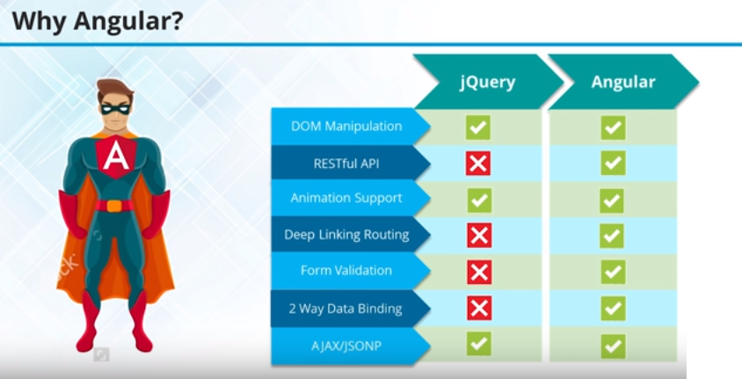

Slide 12
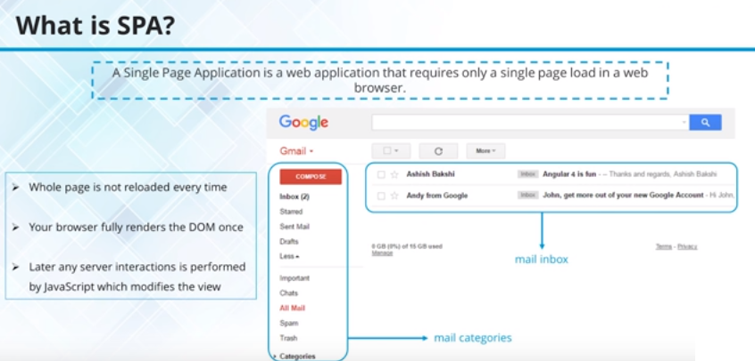

Single Page Applications

Slide 13
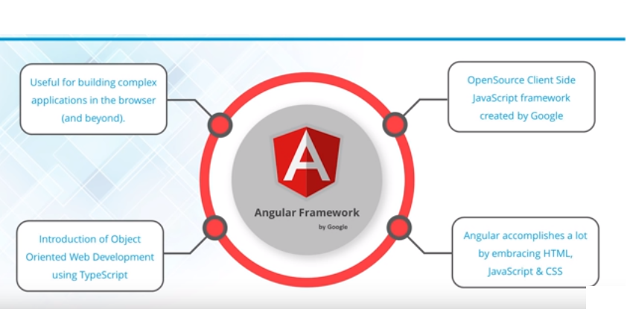
Angular Introduction

Slide 14
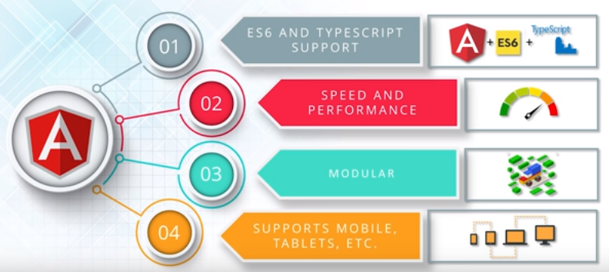
Angular Features

Slide 15
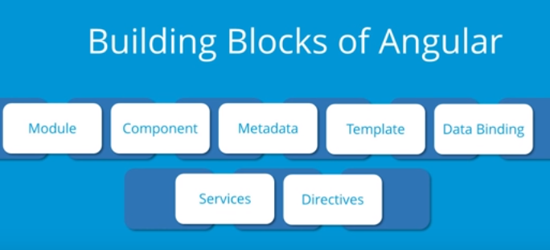

Slide 16
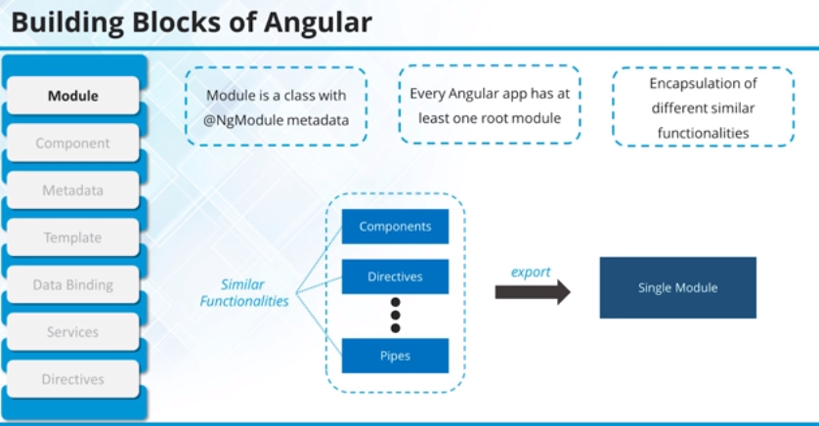
The Angular Module (NgModules) helps us to organize an application into connected blocks of functionality.

Slide 17
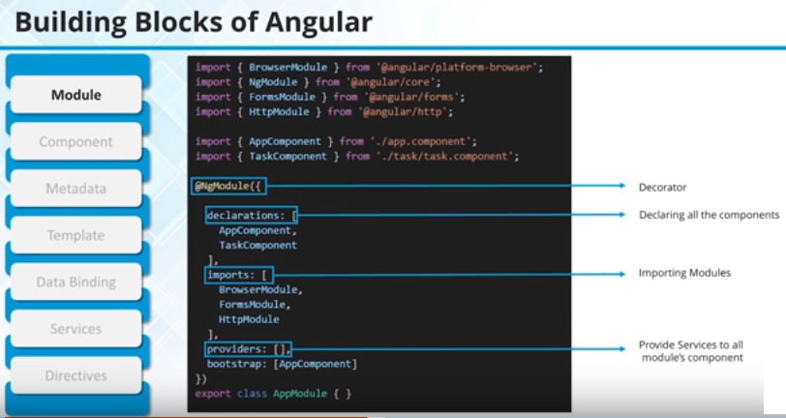

Slide 18
Every Angular app has a root module, conventionally named AppModule, which provides the bootstrap mechanism that launches the application. An app typically contains many functional modules.
// app.module.ts
import { BrowserModule } from '@angular/platform-browser';
import { NgModule } from '@angular/core';
import { AppRoutingModule } from './app-routing.module';
import { AppComponent } from './app.component';
@NgModule({
declarations: [
AppComponent
],
imports: [
BrowserModule,
AppRoutingModule
],
providers: [],
bootstrap: [AppComponent]
})
export class AppModule { }

Slide 19
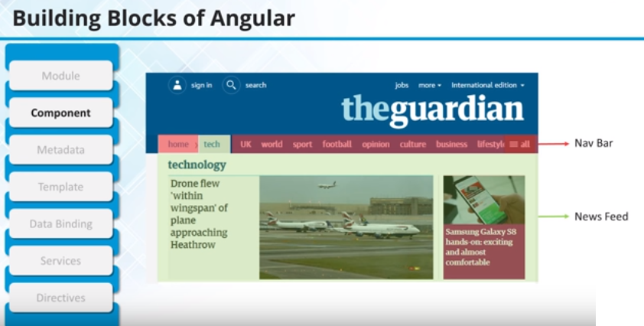
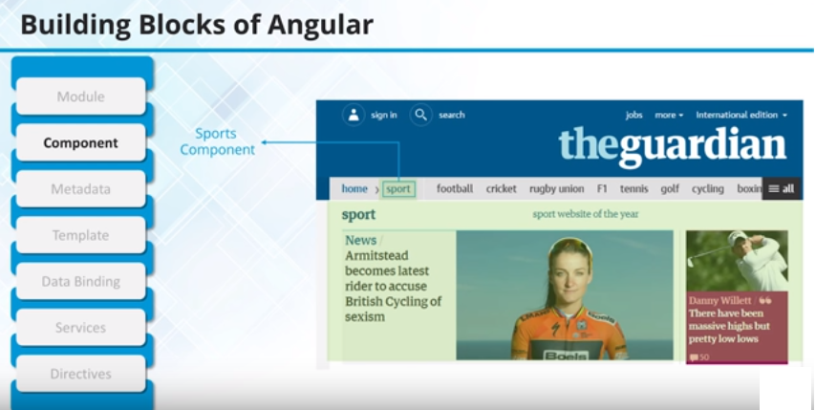

Slide 20
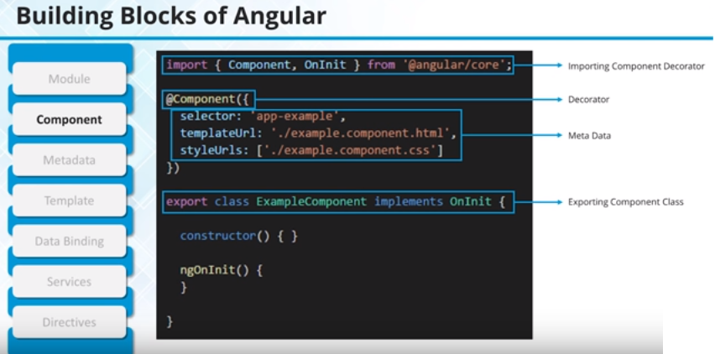

Slide 21
Every Angular project has at least one component, the root component and root component connects the component hierarchy with a page document object model (DOM). Each component defines the class that contains application data and logic, and it is associated with the HTML template that defines the view to be displayed in a target app.
The @Component decorator identifies the class immediately below it as the component and provides the template and related component-specific metadata.
// app.component.ts
@Component({
selector: 'app-root',
templateUrl: './app.component.html',
styleUrls: ['./app.component.css']
})

Slide 22
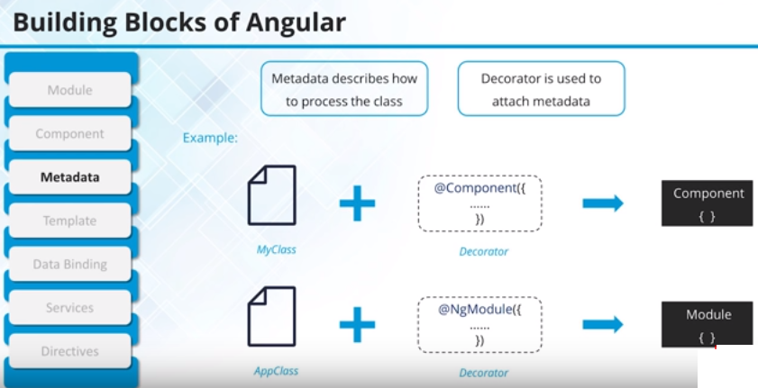
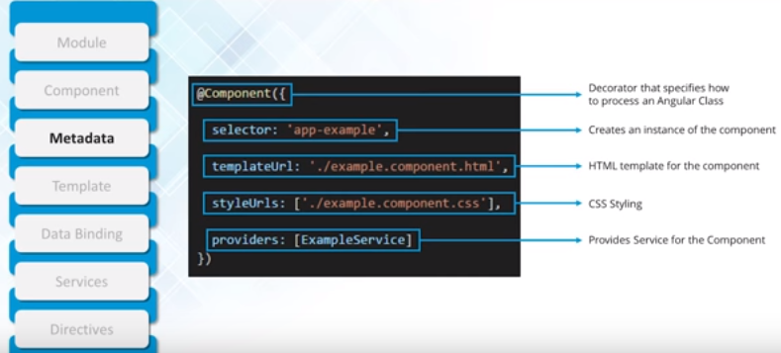

Slide 23
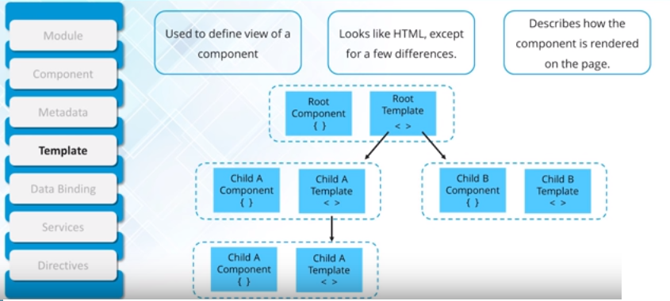
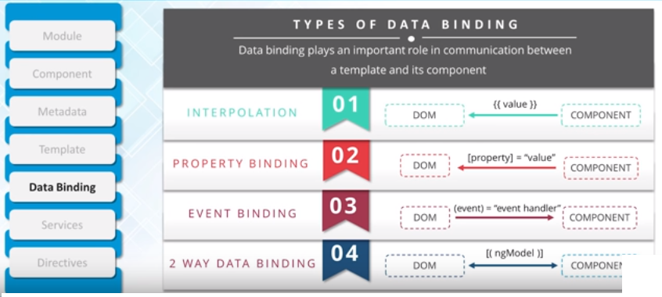

Slide 24
Data Binding
Angular allows defining communication between a component and the DOM, making it very easy to define interactive applications without worrying about pulling and pushing the data.
From the Component to the DOM
Interpolation: {{ value }}: Interpolation adds the value of the property from the component.
Property binding: [property]=”value”
With property binding, a value is passed from a component to a specified property, which can often be a simple html attribute.
<input type="text" [value]="student.name" />
<input type="text" [value]="student.college" />

Slide 25
Services
For data or logic that isn’t associated with a specific view, and that you want to share across components, you create a service class. The @Injectable decorator immediately precedes the service class definition. The decorator provides the metadata that allows your service to be injected into client components as a dependency. Angular distinguishes components from services to increase modularity and reusability. By separating a component’s view-related functionality from other kinds of processing, you can make your component classes lean and efficient.
Dependency Injection
Dependency injection (DI) lets you keep your component classes lean and efficient. DI does not fetch data from a server, validate the user input, or log directly to the console instead they delegate such tasks to the services. DI is wired into a Angular framework and used everywhere to provide new components with the services or other things they need. Components consume services; that is, you can inject a service into a component, giving the component access to that service class.

Slide 26
TypeScript Configuration
TypeScript is a primary language for Angular application development. It is a superset of JavaScript with design-time support for type safety and tooling.
Browsers can't execute TypeScript directly. Typescript must be "transpiled" into JavaScript using the tsc compiler, which requires some configuration.
This page covers some aspects of TypeScript configuration and the TypeScript environment that are important to Angular developers, including details about the following files:
tsconfig.json—TypeScript compiler configuration.

Slide 27
Workspace and file structure:
The Angular CLI command ng new <project_name> gets you started. When you run this
command, the CLI installs the necessary Angular npm packages and other dependencies
in a new workspace, with a root folder named project_name. It also creates the following
workspace and starter project files:
An initial skeleton app project, also called project_name (in the src/ subfolder).
An end-to-end test project (in the e2e/ subfolder).
Related configuration files.
The initial app project contains a simple Welcome app, ready to run.

Slide 28
.editorconfig Configuration for code editors.
.gitignore Specifies intentionally untracked files that Git should ignore.
angular.json CLI configuration defaults for all projects in the workspace, including configuration options for build, serve, and test tools that the CLI uses, such as TSLint, Karma, and Protractor. For details, see Angular Workspace Configuration.
node_modules Provides npm packages to the entire workspace.
package.json Configures npm package dependencies that are available to all projects in the workspace. See npm documentation for the specific format and contents of this file.
package-lock.json Provides version information for all packages installed into node_modules by the npm client. See npm documentation for details. If you use the yarn client, this file will be yarn.lock instead.
tsconfig.json Default TypeScript configuration for apps in the workspace, including TypeScript and Angular template compiler options.
tslint.json Default TSLint configuration for apps in the workspace.
README.md Introductory documentation.

Slide 29
App source folder
app/app.component.ts Defines the logic for the app's root component, named AppComponent. The view associated with this root component becomes the root of the view hierarchy as you add components and services to your app.
app/app.component.html Defines the HTML template associated with the root AppComponent.
app/app.component.css Defines the base CSS stylesheet for the root AppComponent.
app/app.component.spec.ts Defines a unit test for the root AppComponent.
app/app.module.ts Defines the root module, named AppModule, that tells Angular how to assemble the application. Initially declares only the AppComponent. As you add more components to the app, they must be declared here.
assets/* Contains image files and other asset files to be copied as-is when you build your application.

Slide 30

Angular Installation
Download Nodejs-
https://nodejs.org/en/
Steps for Angular:
npm install -g @angular/cli (npm – node package manager)
ng new my-dream-app (ng means angular)
cd my-dream-app (current directory)
ng serve
ng new:
The Angular CLI makes it easy to create an application that already work.
ng generate
Generate components, routes, services and pipes with a simple command.
ng serve
Easily test your app locally while developing.

Slide 31
Template − This is used to render the view for the application. This contains the HTML that needs to be rendered in the application. This part also includes the binding and directives.
Class − This is like a class defined in any language such as C. This contains properties and methods. This has the code which is used to support the view. It is defined in TypeScript.
The class normally has the following syntax in TypeScript.
Syntax
class classname {
Propertyname: PropertyType = Value
}
Parameters
Classname − This is the name to be given to the class.
Propertyname − This is the name to be given to the property.
PropertyType − Since TypeScript is strongly typed, you need to give a type to the property.
Value − This is the value to be given to the property.

Slide 32
export class AppComponent {
appTitle: string = 'Welcome';
}
In the example, the following things need to be noted −
We are defining a class called AppComponent.
The export keyword is used so that the component can be used in other modules in the Angular JS application.
appTitle is the name of the property.
The property is given the type of string.
The property is given a value of ‘Welcome’.

Slide 33
Template
This is the view which needs to be rendered in the application.
Syntax
Template: '
<HTML code>
class properties
'
template: '
<div>
<h1>{{appTitle}}</h1>
<div>Hi Team </div>
</div>
'
In the example, the following things need to be noted −
We are defining the HTML code which will be rendered in our application
We are also referencing the appTitle property from our class.

Slide 34
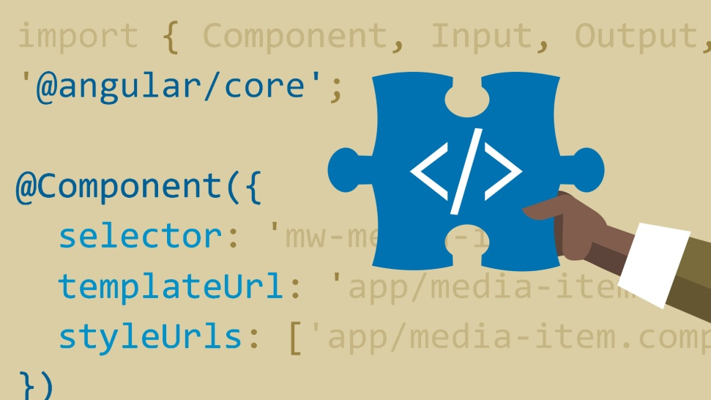
Metadata − This has the extra data defined for the Angular class. It is defined with a decorator(A Decorator is a special kind of declaration that can be attached to a class declaration, method, accessor, property, or parameter. Decorators use the form @expression)
import { Component } from '@angular/core';
@Component ({
selector: 'my-app',
template: ` <div>
<h1>{{appTitle}}</h1>
<div> Hello Team</div>
</div> `,
})
export class AppComponent {
appTitle: string = 'Welcome';
}
In the above example, the following things need to be noted −
We are using the import keyword to import the ‘Component’ decorator from the angular/core module.
We are then using the decorator to define a component.
The component has a selector called ‘my-app’. This is nothing but our custom html tag which can be used in our main html page.

Slide 35
Module in Angular refers to a place where you can group the components, directives, pipes, and services, which are related to the application.
In case you are developing a website, the header, footer, left, center and the right section become part of a module.
When you create a new project using the Angular –cli command, the ngmodule is created in the app.module.ts file by default.
Declaration
It is an array of components created. If any new component gets created, it will be imported first and the reference will be included in declarations as shown below −
declarations: [
AppComponent,
NewCmpComponent
]
Import
It is an array of modules required to be used in the application. It can also be used by the components in the Declaration array. For example, right now in the @NgModule we see the Browser Module imported
import { FormsModule } from '@angular/forms';
The import in the @NgModule will be like the following −
imports: [
BrowserModule,
FormsModule
]

Slide 36
Expressions are used to bind application data to HTML. Expressions are written inside double curly braces such as in {{ expression}}
Using numbers:
<p>Expense on Books : {{cost * quantity}} Rs</p>
Using Strings:
<p>Hello {{student.firstname + " " + student.lastname}}!</p>
Using Object:
<p>Roll No: {{student.rollno}}</p>
Using Array:
<p>Marks(Math): {{marks[3]}}</p>

Slide 37
A component in Angular is a class with a template and a decorator. So in simple terms a component in Angular is composed of these 3 things
Template - Defines the user interface. Contains the HTML, directives and bindings.
Class - Contains the code required for template. Just like a class in any object oriented programming language like C# or Java, a class in angular can contain methods and properties. Properties contain the data that we want to display in the view template and methods contain the logic for the view. We use TypeScript to create the class.
Decorator - We use the Component decorator provided by Angular to add metadata to the class. A class becomes an Angular component, when it is decorated with the Component decorator.

Slide 38
Component Example :
// Component decorator is provided by the Angular core library, so we // have to import it before using it. The import keyword is similar to
// using keyword in C#. Any exported member can be imported using import // keyowrd.
import { Component } from '@angular/core';
// The class is decorated with Component decorator which adds metadata
// to the class. We use the @ symbol to apply a decorator to the class
// Applying a decorator on a class is similar to applying an attribute
// to a class in C# or other programming languages. Component is just
// one of the deveral built-in decorators provided by angular.
@Component({
// component has several properties. Here we are using just 2. For
// the full list of properties refer to the following URL // https://angular.io/docs/ts/latest/api/core/index/Component-decorator.html
// To use this component on any HTML page we specify the selector
// This selector becomes the directive <my-app> on the HTML page
// At run time, the directive <my-app> is replaced by the template // HTML specified below
selector: 'my-app',
// The template contains the HTML to render. Notice in the HTML
// we have a data-binding expression specified by double curly
// braces. We have a defualt value "Angular" assigned to "name"
// property in the AppComponent class. This will be used at runtime
// inplace of the data-binding expression
template: `<h1>Hello {{name}}</h1>`,
})
// export keyword allows this class to be exported, so other components
// in the application can import and use it if required
export class AppComponent {
// name is a property and the data type is string and
// has a default value "angular"
name: string = 'Angular';
}

Slide 39
Angular template vs templateurl:
template and templateurl properties of the Component decorator.
we have used an inline view template. Notice the code we have implemented in app.component.ts file. We have embedded the view template inline in the .ts file.
import { Component } from '@angular/core';
@Component({
selector: 'my-app',
template: `<h1>Hello {{name }}</h1>`
})
export class AppComponent {
name: string = 'Angular';
}

Slide 40
The view template is inline in a pair of backtick characters. The first question that comes to our mind is can't we include the HTML in a pair of single or double quotes. The answer is "YES" we can as long as the HTML is in a single line. So this means the above code can be rewritten using a pair of single quotes as shown below.
template: '<h1>Hello {{name }}</h1>'
We can also replace the pair of single quotes with a pair of double quotes as shown below, and the application still continues to work exactly the same way as before.
template: "<h1>Hello {{name }}</h1>"
The obvious next question that comes to our mind is when should we use backticks instead of single or doublequotes
If you have the HTML in more than one line, then you have to use backticks instead of single or double quotes as shown below. If you use single or double quotes instead of backticks you will get an error.
template: `<h1>
Hello {{name }}
</h1>`

Slide 41
Step 1 : Right click on the "app" folder and add a new HTML file. Name it "app.component.html".
Step 2 : Include the following HTML in "app.component.html"
<h1>
Hello {{name}}
</h1>
Step 3 : In "app.component.ts", reference the external view template using templateUrl property as shown below. Notice instead of the "template" property we are using "templateUrl" property. Please note that templateUrl path is relative to index.html
import { Component } from '@angular/core';
@Component({
selector: 'my-app',
templateUrl: 'app/app.component.html'
})
export class AppComponent {
name: string = "Angular";
}

Slide 42
It is also possible to concatenate a hard-coded string with the property value
<h1>{{'Name = ' + firstName}}</h1>
The above expression displays "Name = Tom" in the browser.
You can specify any valid expression in double curly braces. For example you can have
<h1>{{ 10 + 20 + 30 }}</h1>
The above expression evaluates to 60
The expression that is enclosed in double curly braces is commonly called as Template Expression. This template expression can also be a ternary operator as shown in the example below. Since firstName property has a value 'Tom', we see it in the browser.
import { Component } from '@angular/core';
@Component({
selector: 'my-app',
template: `
<h1>{{firstName ? firstName : 'No name specified'}}</h1>
`
})
export class AppComponent {
firstName: string = 'Tom';
}
If we set firstName = null as shown below. The value 'No name specified' is displayed in the browser firstName: string = null;

Slide 43
You can also use interpolation to set <img> src as shown in the example below.
import { Component } from '@angular/core';
@Component({
selector: 'my-app',
template: `<div>
<h1>{{pageHeader}}</h1>
<img src='{{imagePath}}'/>
</div>`
})
export class AppComponent {
pageHeader: string = 'Employee Details';
imagePath: string = 'http://abcd.com/images/logo.jpg';
}

Slide 44
We can also call class methods using interpolation as shown below.
import { Component } from '@angular/core';
@Component({
selector: 'my-app',
template: `<div>
<h1>{{'Full Name = ' + getFullName()}}</h1>
</div>`
})
export class AppComponent {
firstName: string = 'Tom';
lastName: string = 'Hopkins';
getFullName(): string {
return this.firstName + ' ' + this.lastName;
}
}
Output : Full Name = Tom Hopkins

Slide 45
Angular Event Binding
When a user performs any action like clicking on a button, hovering over an element,
selecting from a dropdownlist, typing in a textbox etc, then the corresponding event for
that action is raised. We need to know when user performs these actions. We can
use angular event binding to get notified when these events occur.
For example the following is the syntax for binding to the click event of a button.
Within parentheses on the left of the equal sign we have the target event, (click) in this
case and on the right we have the template statement. In this case the onClick() method
of the component class is called when the click event occurs.
<button (click)="onClick()">Click me</button>
With event binding we can also use the on- prefix alternative as shown below. This
is known as the canonical form
<button on-click="onClick()">Click me</button>

Slide 46
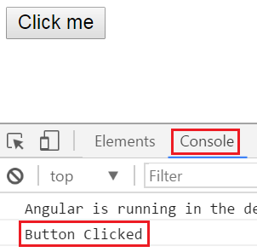
Event Binding Example :
import { Component } from '@angular/core';
@Component({
selector: 'my-app',
template: `<button (click)='onClick()' >Click me</button>`
})
export class AppComponent {
onClick(): void {
console.log('Button Clicked');
}
}
Every time we click the button,
'Button Clicked' message is logged to the console.
You can see this message under the Console tab,
in the browser developer tools.

Slide 47
Two way Data Binding in Angular
Consider the following code in app.component.ts
import { Component } from '@angular/core';
@Component({
selector: 'my-app',
template: `
Name : <input [value]='name'>
<br>
You entered : {{name}}
`
})
export class AppComponent {
name: string = 'Tom';
}
<input [value]='name'> : Binds component class "name" property to the input element’s value property
You entered : {{name}} : Interpolation displays the value we have in "name" property on the web page

Slide 48
In short two-way data binding in Angular is a combination of both Property Binding and Event Binding. To save a few keystrokes and simplify two-way data binding angular has provided ngModel directive.
Like this : Name : <input [(ngModel)]='name'>
This is because ngModel directive is, in an Angular system module called FormsModule. For us to be able to use ngModel directive in our root module - AppModule, we will have to import FormsModule first.
Here are the steps to import FormsModule into our AppModule
1. Open app.module.ts file
2. Include the following import statement in it
import { FormsModule } from '@angular/forms';
3. Also, include FormsModule in the 'imports' array of @NgModule
imports: [BrowserModule, FormsModule]

Slide 49
With these changes, reload the web page and it will work as expected.
So here is the syntax for using two-way data binding in Angular
<input [(ngModel)]='name'>
The square brackets on the outside are for property binding
The parentheses on the inside are for event binding
To easily remember this syntax, compare it to a banana in a box [()]

Slide 50
Angular ngFor directive
Let us understand ngFor structural directive with an example. Consider the following array of Employee objects.
employees: any[] = [
{
code: 'emp101', name: 'Tom', gender: 'Male',
annualSalary: 5500, dateOfBirth: '25/6/1988'
},
{
code: 'emp102', name: 'Alex', gender: 'Male',
annualSalary: 5700.95, dateOfBirth: '9/6/1982'
},
{
code: 'emp103', name: 'Mike', gender: 'Male',
annualSalary: 5900, dateOfBirth: '12/8/1979'
},
{
code: 'emp104', name: 'Mary', gender: 'Female',
annualSalary: 6500.826, dateOfBirth: '14/10/1980'
},
];

Slide 51
Step 1 : Add a new TypeScript file to the "employee" folder. Name it employeeList.component.ts. Copy and paste the following code in it.
import { Component } from '@angular/core';
@Component({
selector: 'list-employee',
templateUrl: 'app/employee/employeeList.component.html',
styleUrls: ['app/employee/employeeList.component.css']
})
export class EmployeeListComponent {
employees: any[] = [
{
code: 'emp101', name: 'Tom', gender: 'Male',
annualSalary: 5500, dateOfBirth: '25/6/1988'
},
{
code: 'emp102', name: 'Alex', gender: 'Male',
annualSalary: 5700.95, dateOfBirth: '9/6/1982'
},
{
code: 'emp103', name: 'Mike', gender: 'Male',
annualSalary: 5900, dateOfBirth: '12/8/1979'
},
{
code: 'emp104', name: 'Mary', gender: 'Female',
annualSalary: 6500.826, dateOfBirth: '14/10/1980'
},
];
}

Slide 52
Step 2 : Add a new HTML page to the "employee" folder. Name it employeeList.component.html. Copy and paste the following code in it.
Please note :
ngFor is usually used to display an array of items
Since ngFor is a structural directive it is prefixed with *
*ngFor='let employee of employees' - In this example 'employee' is called template input variable, which can be accessed by the <tr> element and any of it's child elements.
ngIf structural directive displays the row "No employees to display" when employees property does not exist or when there are ZERO employees in the array

Slide 53
<table>
<thead>
<tr>
<th>Code</th>
<th>Name</th>
<th>Gender</th>
<th>Annual Salary</th>
<th>Date of Birth</th>
</tr>
</thead>
<tbody>
<tr *ngFor='let employee of employees'>
<td>{{employee.code}}</td>
<td>{{employee.name}}</td>
<td>{{employee.gender}}</td>
<td>{{employee.annualSalary}}</td>
<td>{{employee.dateOfBirth}}</td>
</tr>
<tr *ngIf="!employees || employees.length==0">
<td colspan="5">
No employees to display
</td>
</tr>
</tbody>
</table>

Slide 54
Step 3 : Add a new StyleSheet to the "employee" folder. Name it employeeList.component.css.
Step 4 : In the root module, i.e app.module.ts, import employeeList component and add it to the declarations array as shown below.
import { NgModule } from '@angular/core';
import { BrowserModule } from '@angular/platform-browser';
import { AppComponent } from './app.component';
import { EmployeeComponent } from './employee/employee.component';
import { EmployeeListComponent } from './employee/employeeList.component';
@NgModule({
imports: [BrowserModule],
declarations: [AppComponent, EmployeeComponent, EmployeeListComponent],
bootstrap: [AppComponent]
})
export class AppModule { }

Slide 55
Step 5 : In the root component, i.e app.component.ts use employeeList component as a directive as shown below.
import { Component } from '@angular/core';
@Component({
selector: 'my-app',
template: `<list-employee></list-employee>`
})
export class AppComponent { }
At this point, run the application and notice the employees are displayed in the table as expected.

Slide 56
Interfaces in Angular
What is an Interface in TypeScript
If you have experience with any object oriented oriented programming language like C#, Java or C++, then you know an interface is an abstract type. It only contain declarations of properties, methods and events. The implementation for the interface members is provided by a class that implements the interface.
export interface IEmployee {
code: string;
name: string;
gender: string;
annualSalary: number;
dateOfBirth: string;
}

Slide 57
With this IEmployee interface in place, we can now import and use the interface type as the type for "employees" property. The code in EmployeeListComponent class is shown below.
import { IEmployee } from './employee';
export class EmployeeListComponent {
employees: IEmployee[];
}
Since we have specified a type for the "employees" property, we now get intellisense for the object properties in the array

Slide 58
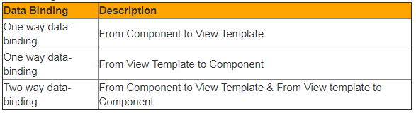

Angular interpolation
Interpolation is all about data binding. In Angular data-binding can be broadly classified into 3 categories
One way data-binding - From Component to View Template : To display read-only data on a view template we use one-way data binding technique interpolation. With interpolation, we place the component property name in the view template, enclosed in double curly braces: {{propertyName}}.
import { Component } from '@angular/core';
@Component({
selector: 'my-app',
template: `
<h1>{{ firstName }}</h1>
`
})
export class AppComponent {
firstName: string = 'Tom';
}

Slide 59
What are the differences between template and templateUrl properties and when to use one over the other Angular recommends to extract templates into a separate file, if the view template is longer than 3 lines. Let's understand why is it better to extract a view template into a seprate file, if it is longer than 3 lines.
With an inline template
We loose Visual Studio editor intellisense, code-completion and formatting features.
TypeScript code is not easier to read and understand when it is mixed with the inline template HTML.
With an external view template
We have Visual Studio editor intellisense, code-completion and formatting features and
Not only the code in "app.component.ts" is clean, it is also easier to read and understand

Slide 60
Directives are used to extend HTML. They are special attributes starting with ng-prefix. Let us discuss the following directives −
ng-app − This directive starts an Angular Application.
ng-init − This directive initializes application data.
ng-model − This directive defines the model that is variable to be used in Angular.
ng-repeat − This directive repeats HTML elements for each item in a collection.
The ng-app directive starts an Angular Application. It defines the root element. It automatically initializes or bootstraps the application when the web page containing Angular Application is loaded. It is also used to load various Angular modules in Angular Application.

Slide 61
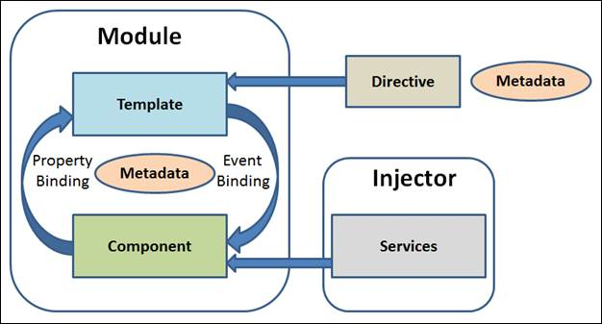
Angular is application for tree of components
Angular Applications are Modular
Every Angular App has at least one module: the root app
Each Application has:
Declarations:
Exports:
Imports:
Providers:
Metadata:
Tell Angular how to process a class.
Selector:
TemplateURL
Providers:
Other Metdata decorators include:
@injectable, @Input, @Output

Slide 62
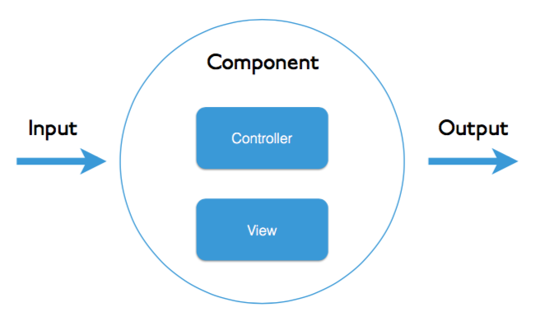
Example of angular 6 element
Now let’s begin with new component
Step1 : Ng g c temp
Components are the most basic UI building block of an Angular app. An Angular app contains a tree of Angular components.
A component controls a patch of screen called a view.

Slide 63

After Angular Installation
Create Component and Overview
<app-root> Root component
Single component contains “app”.
App.component.css
App.component.html
App.component.spec.ts (logic)
Above three files provide functionality
Add !!!
See change.
App.component.ts:
title = 'FirstAppApp';
appcompoent.css:
h1 {
color:green;
}

Slide 64
Creating your own component:
Every component has html ts & css files:
Binding data to component class:
<p>
date works! {{ message }}
</p>
export class DateComponent implements OnInit {
message: string = "hello";
message: string = new Date().toDateString();
Output: date works! Sat Nov 10 2018

Slide 65
Data binding and async
export class DateComponent implements OnInit {
message: string ;
constructor() {
//Angular6 setInterval
setInterval((){
let curr= new Date();
this.message = curr;
},1000
)
}

Slide 66
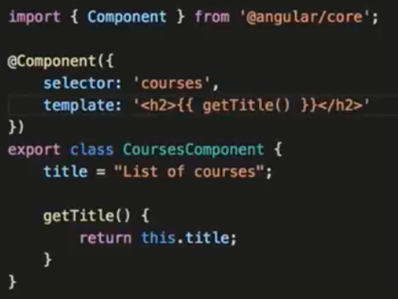
Angular Templates:

Slide 67
Template Interpolation:
{{ someNo + 1 }}
message: string ;
someNo : number = 10;
--
{{ addTwoNumbers(1,8)}}
addTwoNumbers(a: number, b:number){
return a+b;
}

Slide 68
ngFor:
<div>
<h1> {{ user.name }} </h1>
<h2> {{ user.title }} </h2>
<h3> {{ user.address }} </h3>
<!-- <h4> {{ user.phone[0] }} </h4>
<h4> {{ user.phone[1] }} </h4> -->
<h4 *ngFor="let phoneNo of user.phone">{{ phoneNo}}</h4>
</div>
this.user = {
name: 'HelloTeamm',
title: 'Developer',
address: '123456789',
phone: [
'123456789',
'158932142',
'158932142',
'123456789'
];
};

Slide 69
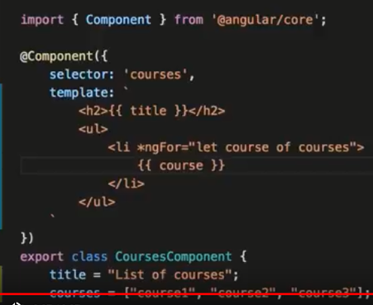
Directives:
AngularJS directives are extended HTML attributes with the prefix ng- . The ng-app directive initializes an AngularJS application. The ng-model directive binds the value of HTML controls (input, select, textarea) to application data.
Backtiks can be used to make more lines and readable.

Slide 70
Include Bootstrap:
Npm install bootstrap
and
Configure angular.json:
"styles": [
"node_modules/bootstrap/dist/css/bootstrap.min.css",
"styles.scss"
]
2: Import directly in src/style.css or src/style.scss:
@import '~bootstrap/dist/css/bootstrap.min.css';

Slide 71
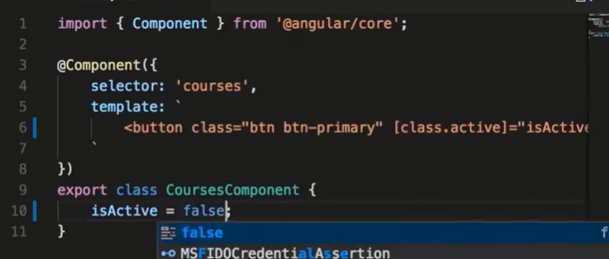
Add a Button After Bootstrap:
template: `
<button class='btn btn-primary'>Team </button>
`
Class Binding:
template: `
<button class='btn btn-primary' [class.active]="isActive">Team </button>
`

Slide 72
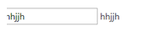
Two Way Binding:
import { Component, OnInit } from '@angular/core';
@Component({
selector: 'app-courses',
templateUrl: './courses.component.html',
styleUrls: ['./courses.component.css'] ,
template: `
<input [(ngModel)]="name" type="text"> {{ name }}
`
})
export class CoursesComponent implements OnInit {
name="";
constructor() { }
ngOnInit() {
}
}

Slide 73
Pipes:
import { Component, OnInit } from '@angular/core';
@Component({
selector: 'app-courses',
templateUrl: './courses.component.html',
styleUrls: ['./courses.component.css'] ,
template: `
{{course.title |uppercase}} <br/>
{{course.students | number}} <br/>
{{course.rating | number}} <br/>
{{course.price | currency:'AUD'}} <br/>
{{course.releaseDate | date:'shortDate' }}
`
})
export class CoursesComponent implements OnInit {
course = {
title: "Hi Team Angular Tutorial",
rating: 4.975,
students: 30124,
price: 190.25,
releaseDate: new Date(2018,4.1)
}
}

Slide 74
Angular routing:
Web applications can have different sections that correspond to different URLs, and supporting those sections programmatically is called routing.
In Simple words, As per Url, open different angular components is called routing.
URL Component
http://localhost:4200/home Home.component
http://localhost:4200/aboutus Aboutus.component
http://localhost:4200/contactus ContactUs.Component
Package that must be import:
import { Routes, RouterModule } from ‘@angular/Router’;

Slide 75
Example:
Step1 : First Create three components home,aboutus,contactus.
Step2: Configure app.module.ts as follows.
import { BrowserModule } from '@angular/platform-browser';
import { NgModule, Component } from '@angular/core';
import { FormsModule } from '@angular/forms';
import { HttpModule } from '@angular/http';
import { Routes, RouterModule } from '@angular/Router';
import { AppComponent } from './app.component';
import { AboutusComponent } from './aboutus/aboutus.component';
import { ContactusComponent } from './contactus/contactus.component';
import { HomeComponent } from './home/home.component';
const AppRoutes: Routes = [
{ path: 'about', component: AboutusComponent },
{ path: 'Home', component: HomeComponent },
{ path: 'ContactUs', component: ContactusComponent }
]
@NgModule({
declarations: [
AppComponent,
AboutusComponent,
ContactusComponent,
HomeComponent,
],
imports: [
BrowserModule,
FormsModule,
HttpModule,
RouterModule.forRoot(AppRoutes)
],
// Add provider
providers: [],
bootstrap: [AppComponent]
})
export class AppModule { }

Slide 76
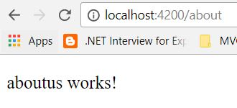
Make changes in app.component.ts as follows
import { Component } from '@angular/core';
@Component({
selector: 'app-root',
template: `
<router-outlet></router-outlet>
`,
styles: [`
p
{
background-color:silver;
font-size : 26px;
}
`],
})
export class AppComponent {
}

Slide 77
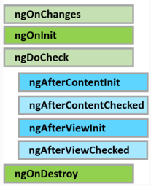
Angular component lifecycle hooks
A component has a lifecycle managed by Angular. Angular
Creates the component
Renders the component
Creates and renders the component children
Checks when the component data-bound properties change, and
Destroys the component before removing it from the DOM
To tap into and react when these life cycle events occur, angular offers several lifecycle hooks as shown in the image below.

Slide 78
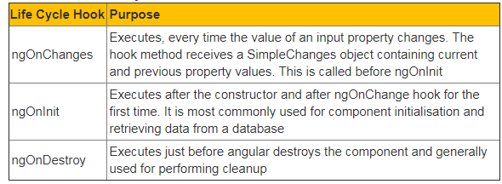
The 3 most commonly used hooks are

Slide 79
There are 3 simple steps to use the Life Cycle Hooks
Step 1 : Import the Life Cycle Hook interface. For example, to use ngOnInit() life cycle hook, import OnInit interface.
import { OnInit } from '@angular/core';
Step 2 : Make the component class implement the Life Cycle Hook interface, using the implements keyword as shown below. This step is optional, but good to have so you will get editor support and flags errors at compile time if you incorrectly implement the interface method or make any typographical errors.
export class SimpleComponent implements OnInit { }
Step 3 : Write the implementation code for the life cycle interface method. Each interface has a single hook method whose name is the interface name prefixed with ng.
ngOnInit() {
console.log('OnInit Life Cycle Hook');
}

Slide 80
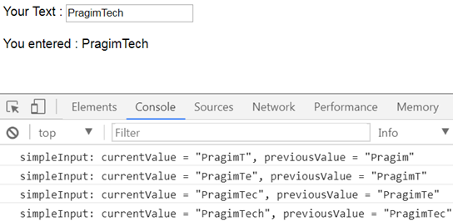
Let's understand ngOnChanges life cycle hook with a simple example. Here is what we want to do. As soon as the user starts typing into the text box, we want to capture the current and previous value and log it to the browser console as shown below. We can very easily achieve this by using the ngOnChanges life cycle hook.

Slide 81
ngOnChanges, is called every time the value of an input property of a component changes. So first let's create a SimpleComponent with an input property as shown below.
Add a new folder in the App folder and name it Others. Add a new TypeScript file to this folder and name it - simple.component.ts.
// Step 1 : Import OnChanges and SimpleChanges
import { Component, Input, OnChanges, SimpleChanges } from '@angular/core';
// The selector "simple" will be used as the directive // where we want to use this component. Notice we are
// also using the simpleInput property with interpolation // to display the value it receives from the parent // component
@Component({
selector: 'simple',
template: `You entered : {{simpleInput}}`
})
// Step 2 : Implement OnChanges Life Cycle Hook interface
export class SimpleComponent implements OnChanges {
// Input property. As and when this property changes
// ngOnChanges life cycle hook method is called
@Input() simpleInput: string;
// Step 3 : Implementation for the hook method
// This code logs the current and previous value
// to the console.
ngOnChanges(changes: SimpleChanges) {
for (let propertyName in changes) {
let change = changes[propertyName];
let current = JSON.stringify(change.currentValue);
let previous = JSON.stringify(change.previousValue);
console.log(propertyName + ': currentValue = '
+ current + ', previousValue = ' + previous);
// The above line can be rewritten using
// placeholder syntax as shown below
// console.log(`${propertyName}: currentValue
// = ${current }, previousValue = ${previous }`);
}
}
}

Slide 82
Now copy and paste the following code in our root component - app.component.ts
import { Component } from '@angular/core';
// Notice we have placed the text box in this root component
// To keep the value in the textbox and the component property
// value "userText" in sync we are using 2 way data binding
// We have also bound userText property of this component
// to the input property of the SimpleComponent
@Component({
selector: 'my-app',
template: `Your Text : <input type='text' [(ngModel)]='userText'/>
<br/><br/>
<simple [simpleInput]='userText'></simple>
`
})
export class AppComponent {
userText: string = ‘HiTeam';
}

Slide 83
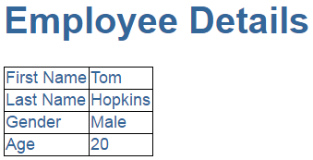
Nested Components:
Nesting angular components i.e including a component inside another component.
As we already know Angular is all about components.
A component in Angular allows us to create a reusable UI widget.
A component can be used by any other component.
Let's look at a simple example of nesting a component inside another component.
Here is what we want to do. Create a page that displays Employee details as shown below.

Slide 84
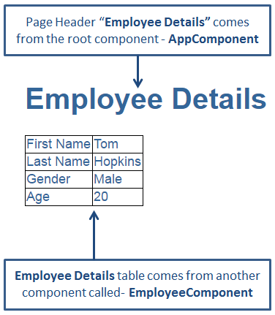
As you can see from the image below we want to create 2 components AppComponent - This component is the root component and displays just the page header
EmployeeComponent - This component is the child component and displays the Employee details table. This child component will be nested inside the root AppComponent

Slide 85
Step 1 : Right click on the "App" folder and add a new folder. Name it "employee". We will create our EmployeeComponent in this folder.
Step 2 : Right click on the "employee" folder and add a new HTML page. Name it employee.component.html. Copy and paste the following HTML.
<table>
<tr>
<td>First Name</td>
<td>{{firstName}}</td>
</tr>
<tr>
<td>Last Name</td>
<td>{{lastName}}</td>
</tr>
<tr>
<td>Gender</td>
<td>{{gender}}</td>
</tr>
<tr>
<td>Age</td>
<td>{{age}}</td>
</tr>
</table>

Slide 86
Step 3 : Right click on the "employee" folder and add a new TypeScript file. Name it employee.component.ts. Copy and paste the following code in it. At this point we have our child component EmployeeComponent created. Next let's create the root component - AppComponent.
import { Component } from '@angular/core';
@Component({
selector: 'my-employee',
templateUrl: 'app/employee/employee.component.html'
})
export class EmployeeComponent {
firstName: string = 'Tom';
lastName: string = 'Hopkins';
gender: string = 'Male';
age: number = 20;
}

Slide 87
Step 4 : We are going to use the root component to just display the page header. So in "app.component.ts" file, include the following code. Notice, since the View Template HTML is just 3 lines we have used an inline template instead of an external template. Angular2 recommends to extract templates into a separate file, if the view template is longer than 3 lines.
import { Component } from '@angular/core';
@Component({
selector: 'my-app',
template: `<div>
<h1>{{pageHeader}}</h1>
</div>`
})
export class AppComponent {
pageHeader: string = 'Employee Details';
}

Slide 88
At this point if we run the application, we only see the page header - "Employee Details", but not the table which has the employee details. To be able to display employee details table along with the page header, we will have to nest EmployeeComponent inside AppComponent. There are 2 simple steps to achieve this.
Step 1 : In "app.module.ts" file we need to do 2 things as shown below.
Import EmployeeComponent
Add EmployeeComponent to the declarations array
import { NgModule } from '@angular/core';
import { BrowserModule } from '@angular/platform-browser';
import { AppComponent } from './app.component';
import { EmployeeComponent } from './employee/employee.component';
@NgModule({
imports: [BrowserModule],
declarations: [AppComponent, EmployeeComponent],
bootstrap: [AppComponent]
})
export class AppModule { }

Slide 89
What is AppModule
AppModule is the root module which bootstraps and launches the angular application. You can name it anything you want, but by convention it is named AppModule.
It imports 2 system modules - BrowserModule and NgModule
BrowserModule - Every application that runs in a browser needs this module. In a later video in this course we will discuss NgIf and NgFor directives which are also provided by this module.
NgModule - @component decorator adds metadata to an angular component class, similarly @NgModule decorator adds metadata to the angular module class.
Properties of the @NgModule decorator
imports - Imports the BrowserModule required for an angular application to run in a web browser
declarations - Contains the components registered with this module. In our case we have two - AppComponent and EmployeeComponent
bootstrap - Contains the root component that Angular creates and inserts into the index.html host web page

Slide 90
Step 2 : In "app.component.ts" file include "my-employee" as a directive. Remember in "employee.component.ts" file we used "my-employee" as a selector.
import { Component } from '@angular/core';
@Component({
selector: 'my-app',
template: `<div>
<h1>{{pageHeader}}</h1>
<my-employee></my-employee>
</div>`
})
export class AppComponent {
pageHeader: string = 'Employee Details';
}
Run the application and you will see both page header and the employee details table. The employee details table is not styled very well. To style the table

Slide 91
Services:
Services are written by just defining a typescript(with extension .service.ts) class
with decorator @Injectable annotation.
Step 1: First we create service using angular cli. Write following angular cli command
into integrated terminal
ng g service data
It will create two files named data.service.ts and data.service.spec.ts.
Step 2: Write the following code into service.ts
import { Injectable } from '@angular/core';
@Injectable()
export class DataService {
// Create array
hobbies = [
'dancing',
'singing',
'internet'
];
constructor() { }
// Create simple angular service method
servicemethod(){
return 'Its just a simple service method';
} }
In the above code block, an array “hobbies” and function “servicemethod” are defined which may be used by any components.

Slide 92
Step 3: Update app.module.ts (Pass the reference to newly created service and add providers)
import { DataService } from './data.service';
import { BrowserModule } from '@angular/platform-browser';
import { NgModule } from '@angular/core';
import { FormsModule } from '@angular/forms';
import { HttpModule } from '@angular/http';
import { AppComponent } from './app.component';
@NgModule({
declarations: [
AppComponent,
],
imports: [
BrowserModule,
FormsModule,
HttpModule
],
// Add provider
providers: [DataService],
bootstrap: [AppComponent]
})
export class AppModule { }

Slide 93
Step4 : Update app.component.ts as following code
import { Component } from '@angular/core';
@Component({
selector: 'app-root',
template: `
<p>hi {{data}}</p>
<li *ngFor="let h of itemsarray">
<b> {{h}} </b>
</li>
`,
styles: [`
p
{
background-color:green;
}
`],
// Don't forget to add reference of DataService
providers:[DataService]
})
export class AppComponent {
// String and array variable declartion
data;
itemsarray=[]
constructor(private dataservice: DataService) {
// use property of service
this.itemsarray = this.dataservice.hobbies;
// use method of service
this.data = this.dataservice.servicemethod();
}
}
In above code our custom service instance “dataservice” is created and using this instance we are
accessing the variable and function of angular custom service.
Next step:
Ng serve

Slide 94
Angular form control and form group:
When working with reactive forms we create instances of FormControl and FormGroup classes to create a form model.
To bind an HTML <form> tag in the template to the FormGroup instance in the component class, we use formGroup directive
To bind an HTML <input> element in the template to the FormControl instance in the component class, we use formControlName directive
formGroup and formControlName directives are provided by the ReactiveFormsModule
FormControl instance tracks the value and state of the individual html element it is associated with FormGroup instance tracks the value and state of all the form controls in it's group

Slide 95
To access the FormGroup properties use, employeeForm property in the component class. When you press DOT on the employeeForm property you can see all the available properties and methods.
To access a FormControl in a FormGroup, we can use one of the following 2 ways.
employeeForm.controls.fullName.value
employeeForm.get('fullName').value

Slide 96
Angular Forms:
There are 2 ways to create forms in Angular
Template Driven Forms
Reactive Forms (Also called Model Driven Forms)
As the name implies, Template Driven Forms are heavy on the template meaning we create the form completely in HTML. Template driven forms are easy to build and understand. They are great for creating simple forms. However, creating complex forms using template driven approach is not recommended as the HTML can get very complicated and messy. It is not easy to unit test template forms as the logic is in the HTML.
Reactive forms on the other hand allow us to build the form completely in code. This is more flexible and has many benefits over template forms. For example, it is easy to add form input elements dynamically and adjust validation at run-time based on the decisions made in code. It is also easy to unit test as most of the logic and validation is in the component class. The only downside of reactive forms is that they require more code than template forms.

Slide 97
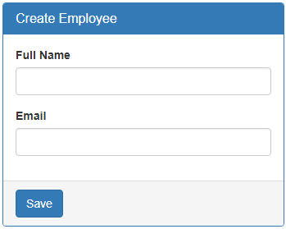

Slide 98
Creating a form group model :
Two classes that we commonly use to create a form control tree is FormGroup and FormControl. As the names imply to create a form with a group of controls, we create an instance of FormGroup class and to create each input element i.e a form control, we create an instance of FormControl class. So in the CreateEmployeeComponent (create-employee.component.ts) class
import { Component, OnInit } from '@angular/core';
// Import FormGroup and FormControl classes
import { FormGroup, FormControl } from '@angular/forms';
@Component({
selector: 'app-create-employee',
templateUrl: './create-employee.component.html',
styleUrls: ['./create-employee.component.css']
})
export class CreateEmployeeComponent implements OnInit {
// This FormGroup contains fullName and Email form controls
employeeForm: FormGroup;
constructor() { }
// Initialise the FormGroup with the 2 FormControls we need.
// ngOnInit ensures the FormGroup and it's form controls are
// created when the component is initialised
ngOnInit() {
this.employeeForm = new FormGroup({
fullName: new FormControl(),
email: new FormControl()
});
}
}

Slide 99
Binding the FormGroup model and the view : Copy and paste the following HTML in create-employee.component.html file. This is pure HTML. There is no Angular code in this HTML. We have a <form> element and 2 text input elements (for fullName and email)
<form class="form-horizontal">
<div class="panel panel-primary">
<div class="panel-heading">
<h3 class="panel-title">Create Employee</h3>
</div>
<div class="panel-body">
<div class="form-group">
<label class="col-sm-2 control-label" for="fullName">Full Name</label>
<div class="col-sm-8">
<input id="fullName" type="text" class="form-control">
</div>
</div>
<div class="form-group">
<label class="col-sm-2 control-label" for="email">Email</label>
<div class="col-sm-8">
<input id="email" type="text" class="form-control">
</div>
</div>
</div>
<div class="panel-footer">
<button class="btn btn-primary" type="submit">Save</button>
</div>
</div>
</form>

Slide 100
Now we need to bind the view template to the form group model we created in the component class. For this we make use of the following 2 directives provided by Angular ReactiveFroms module.
formGroup
formControlName
Here is the modified HTML. Notice the use of formGroup and formControlName directives in the <form> element and the 2 input elements.
<form class="form-horizontal" [formGroup]="employeeForm">
<div class="panel panel-primary">
<div class="panel-heading">
<h3 class="panel-title">Create Employee</h3>
</div>
<div class="panel-body">
<div class="form-group">
<label class="col-sm-2 control-label" for="fullName">Full Name</label>
<div class="col-sm-8">
<input id="fullName" type="text" class="form-control" formControlName="fullName">
</div>
</div>
<div class="form-group">
<label class="col-sm-2 control-label" for="email">Email</label>
<div class="col-sm-8">
<input id="email" type="text" class="form-control" formControlName="email“>
</div>
</div>
</div>
<div class="panel-footer">
<button class="btn btn-primary" type="submit">Save</button>
</div>
</div>
</form>

Slide 101
The 2 directives (formGroup and formControlName) are in ReactiveForms module, but we have not yet imported it in our root module. So in the AppModule (app.module.ts file), import ReactiveFormsModule and include it in the imports array. import { ReactiveFormsModule } from '@angular/forms';
Accessing form data : To access form data, bind to the ngSubmit event on the <form> element. This ngSubmit event is raised when a button with input type=submit is clicked.
<form class="form-horizontal" [formGroup]="employeeForm" (ngSubmit)="onSubmit()">
In the component class (create-employee.component.ts), include onSubmit() method as shown below.
onSubmit(): void {
console.log(this.employeeForm.value);
}
At this point, fill out the form and click Save button. Notice, the Formgroup value property is logged to the console. The value property of the FormGroup contains each form control name and it's associated value.

Slide 102
Model binding in angular template driven forms
At the moment, in CreateEmployeeComponent we are using the Angular Auto-generated form model. Instead of using the Angular generated form model, we can use our model class.
In employee.model.ts file in the models folder, we have Employee class. We want to use this class as the model when creating a new employee. Here are the steps.
Step 1 : In create-employee.component.ts file, import the Employee model
import { Employee } from '../models/employee.model';
Step 2 : In CreateEmployeeComponent class, include employee property. Notice we have set the type to Employee and initialised all properties with NULL value.
export class CreateEmployeeComponent implements OnInit {
employee: Employee = {
id: null,
name: null,
gender: null,
contactPreference: null,
phoneNumber: null,
email: null,
dateOfBirth: null,
department: null,
isActive: null,
photoPath: null
};

Slide 103
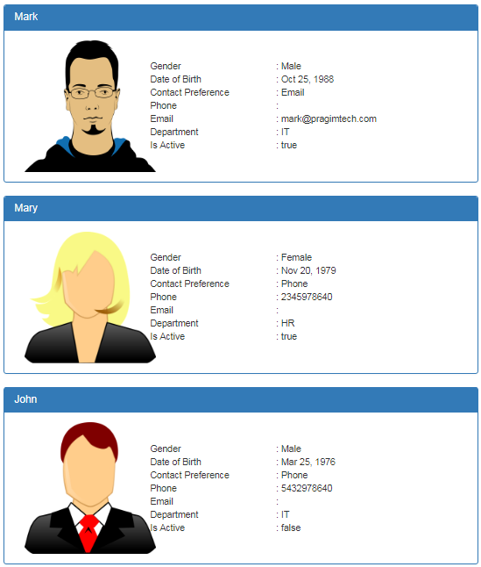
Read Operation in Angular

Slide 104
At the moment, we do not have Employee model. First, let's create the Employee model.
Creating Employee model :
Expand the "src" folder
Right click on the "App" folder, and select "New Folder" from the context menu
Name the folder "models". We will place all our models in this folder
Now add a new file in the "models" folder
Name it "employee.model.ts"
Copy and paste the following code in it
export class Employee {
id: number;
name: string;
gender: string;
email?: string;
phoneNumber?: number;
contactPreference: string;
dateOfBirth: Date;
department: string;
isActive: boolean;
photoPath?: string;
}
Next, create a component to display the list of employees. Name it ListEmployeesComponent.
ng g c employees/listEmployees --spec false --flat true
The above command not only creates the ListEmployeesComponent, it also updates the AppModule.

Slide 105
list-employees.component.ts
import { Component, OnInit } from '@angular/core';
// import Employee Model
import { Employee } from '../models/employee.model';
@Component({
selector: 'app-list-employees',
templateUrl: './list-employees.component.html',
styleUrls: ['./list-employees.component.css']
})
export class ListEmployeesComponent implements OnInit {
//
// how to retrieve this employees data from a database table
employees: Employee[] = [
{
id: 1,
name: 'Mark',
gender: 'Male',
contactPreference: 'Email',
email: 'mark@pragimtech.com',
dateOfBirth: new Date('10/25/1988'),
department: 'IT',
isActive: true,
photoPath: 'assets/images/mark.png'
},
constructor() { }
ngOnInit() {
}
}
{
id: 2,
name: 'Mary',
gender: 'Female',
contactPreference: 'Phone',
phoneNumber: 2345978640,
dateOfBirth: new Date('11/20/1979'),
department: 'HR',
isActive: true,
photoPath: 'assets/images/mary.png'
},
{
id: 3,
name: 'John',
gender: 'Male',
contactPreference: 'Phone',
phoneNumber: 5432978640,
dateOfBirth: new Date('3/25/1976'),
department: 'IT',
isActive: false,
photoPath: 'assets/images/john.png'
},
];

Slide 106
Changes in list-employees.component.html : Replace the existing HTML, with the following HTML. Notice we are using Bootstrap for styling.
<div class="panel panel-primary" *ngFor="let employee of employees">
<div class="panel-heading">
<h3 class="panel-title">{{employee.name}}</h3>
</div>
<div class="panel-body">
<div class="col-xs-10">
<div class="row vertical-align">
<div class="col-xs-4">
<img class="imageClass" [src]="employee.photoPath" />
</div>
<div class="col-xs-8">
<div class="row">
<div class="col-xs-6">
Gender
</div>
<div class="col-xs-6">
: {{employee.gender}}
</div>
</div>
<div class="row">
<div class="col-xs-6">
Date of Birth
</div>
<div class="col-xs-6">
: {{employee.dateOfBirth | date}}
</div>
</div>
<div class="row">
<div class="col-xs-6">
Contact Preference
</div>
<div class="col-xs-6">
: {{employee.contactPreference}}
</div>
</div>
</div>
</div>
</div>
</div>
</div>

Slide 107
Changes in list-employees.component.css : Include the following CSS classes
.imageClass{
width:200px;
height:200px;
}
.vertical-align{
display: flex;
align-items: center;
}
Changes in app.component.html : Include the ListEmployeesComponent selector (app-list-employees) as a directive in the root component (app.component.html)
<div class="container">
<app-list-employees></app-list-employees>
</div>
it also launches your default browser and displays the list of employees as expected.
ng serve -o

Slide 108
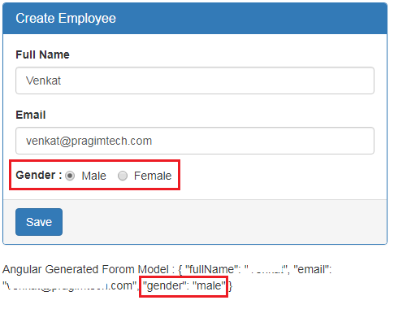
Bootstrap radio buttons in Angular

Slide 109
create-employee.component.html file
<div class="form-group">
<label>Gender</label>
<div class="form-control">
<label class="radio-inline">
<input type="radio" name="gender" value="male" [(ngModel)]="gender">
Male
</label>
<label class="radio-inline">
<input type="radio" name="gender" value="female" [(ngModel)]="gender">
Female
</label>
</div>
</div>
CodeExplanation: The name attribute is required to group the radio buttons as one unit and make the selection mutually exclusive. Make sure both the radio buttons have the same value for the "name" attribute. Otherwise the radio button selection won't be mutually exclusive.
It is also important that you set the "value" attribute for each radio button. This value is posted to the server when the form is submitted.

Slide 110
create-employee.component.html
<form #employeeForm="ngForm" (ngSubmit)="saveEmployee(employeeForm)">
<div class="panel panel-primary">
<div class="panel-heading">
<h3 class="panel-title">Create Employee</h3>
</div>
<div class="panel-body">
<div class="form-group">
<label for="fullName">Full Name</label>
<input id="fullName" type="text" class="form-control" name="fullName"
[(ngModel)]="fullName">
</div>
<div class="form-group">
<label for="email">Email</label>
<input id="email" type="text" class="form-control" name="email"
[(ngModel)]="email">
</div>
<div class="form-group">
<label for="phoneNumber">Phone Number</label>
<input id="phoneNumber" type="text" class="form-control" name="phoneNumber"
[(ngModel)]="phoneNumber">
</div>

Slide 111
<div class="form-group">
<label>Contact Preference</label>
<div class="form-control">
<label class="radio-inline">
<input type="radio" name="contactPreference" value="email"
[(ngModel)]="contactPreference">
Email
</label>
<label class="radio-inline">
<input type="radio" name="contactPreference" value="phone"
[(ngModel)]="contactPreference">
Phone
</label>
</div>
</div>
<div class="form-group">
<label>Gender</label>
<div class="form-control">
<label class="radio-inline">
<input type="radio" name="gender" value="male" [(ngModel)]="gender">
Male
</label>
<label class="radio-inline">
<input type="radio" name="gender" value="female" [(ngModel)]="gender">
Female
</label>
</div>
</div>
</div>
<div class="panel-footer">
<button class="btn btn-primary" type="submit">Save</button>
</div>
</div>
</form>

Slide 112
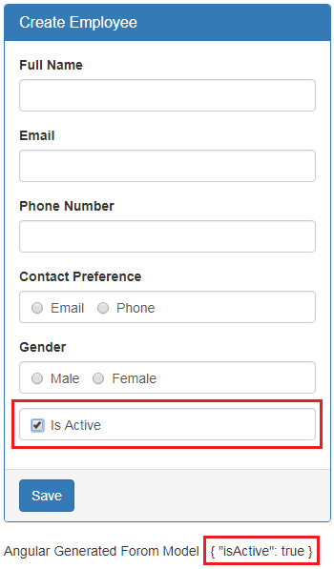
Bootstrap checkbox in angular
Working with a checkbox in Angular is very similar to working with a radio button. We want to include "Is Active" checkbox in the Create Employee form as shown below. When we check the checkbox, "isActive" property should reflect in the Angular generated for model as shown in the image below.

Slide 113
To achieve this all you have to do is include the following HTML in create-employee.component.html file
<div class="form-group">
<div class="form-control">
<label class="checkbox-inline">
<input type="checkbox" name="isActive" [(ngModel)]="isActive">Is Active
</label>
</div>
</div>
If we include "checked" attribute on a checkbox, we expect checkbox to be checked by default when the form initially loads. But you will discover that is not the case.
<input type="checkbox" name="isActive" [(ngModel)]="isActive" checked>
However, if you remove the "ngModel" directive from the checbox, then it gets checked as expected. Notice the "ngModel" directive is removed from the checkbox.
<input type="checkbox" name="isActive" checked>Is Active
To make it work include "isActive" property in the component class and initialise it to true.
isActive = true;

Slide 114
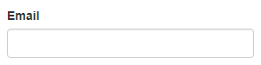
Angular email validation example
Email validation in Angular : There are 2 different ways to validate email form field in Angular. We can either use pattern validator or email validator.
Consider the following HTML. Notice we are using Bootstrap classes for styling.
<div class="form-group">
<label for="email">Email</label>
<input id="email" type="text" class="form-control" name="email"
[(ngModel)]="employee.email">
</div>

Slide 115
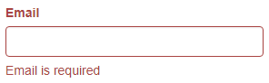
We want to validate this email input field for 2 things
Email is required and
Valid email must be provided
To make email, a required field modify the HTML as shown below
<div class="form-group" [class.has-error]="email.invalid && email.touched">
<label for="email" class="control-label">Email</label>
<input id="email" required type="text" class="form-control" name="email"
[(ngModel)]="employee.email" #email="ngModel">
<span class="help-block" *ngIf="email.invalid && email.touched">
Email is required
</span>
</div>
Code Explanation :
[class.has-error]="email.invalid && email.touched". This is class binding in angular. If the email field is touched and invalid, then the Bootstrap class has-error is added to the div element, else the class is removed.
On the label that displays "Email" text, we applied control-label Bootstrap class. This class turns the label text to red if there is a validation error.
*ngIf="email.invalid && email.touched". Notice the *ngIf structural directive on the span element. If the email field is touched and invalid the span element is added to the DOM, else it is removed. The Bootstrap help-block class on the span element is for styling.
At this point, if you touch the email field and leave it without typing in anything, you will see the validation error message "Email is required"

Slide 116
Angular regular expression validation
With the pattern validator we use a regular expression. Regular expressions are extremely useful when you want to validate if a given string conforms to a specified pattern.
For example, you can use regular expressions to check if a given email conforms to a a valid email format.
Use the following HTML, to display the validation error message. If the email is invalid, angular attaches pattern key to the errors collection. On the other hand, if the email field is valid, the key pattern will not be in the errors collection. The question mark here is called the safe navigation operator.
Example:
<div class="form-group" [class.has-error]="email.invalid && email.touched">
<label for="email" class="control-label">Email</label>
<input required pattern="^[a-zA-Z0-9_.+-]+@[a-zA-Z0-9-]+\.[a-zA-Z0-9-.]+$"
id="email" type="text" class="form-control" name="email"
[(ngModel)]="employee.email" #email="ngModel">
<span class="help-block" *ngIf="email.errors?.required && email.touched">
Email is required
</span>
<span class="help-block" *ngIf="email.errors?.pattern && email.touched">
Email is Invalid
</span>
</div>

Slide 117
Angular 7 Forms Example
#1: Install Angular using Angular CLI
#2: Install Bootstrap 4 in Angular 7
#3: Registering the Reactive Forms Module
#4: Add FormControl class
#5: Registering the control into the template
#6: Updating the form control value

Slide 118
#1Install Angular 7 using Angular CLI
ng new ng7forms
cd ng7forms
ng serve
#2Install Bootstrap 4 in Angular
npm install bootstrap –save &
Now, include the bootstrap 4 inside the angular.json file inside styles array.
"styles": [
"./node_modules/bootstrap/dist/css/bootstrap.min.css",
"src/styles.css"
],
#3: Registering the Reactive Forms Module
We can use the reactive forms by importing ReactiveFormsModule from the @angular/forms package and add it to your app.module.ts file’s imports array. So add the module inside the app.module.ts file.
// app.module.ts
import { ReactiveFormsModule } from '@angular/forms';
@NgModule({
imports: [
// other imports ...
ReactiveFormsModule
],
})

Slide 119
#4: Add FormControl class
The FormControl class is the fundamental building block when using the reactive forms. If we want to register the single form control, we need to import the FormControl class into our component and create the new instance of a form control to save as the class property.
Now, modify the app.component.ts file.
// app.component.ts
import { Component } from '@angular/core';
import { FormControl } from '@angular/forms';
@Component({
selector: 'app-root',
templateUrl: './app.component.html',
styleUrls: ['./app.component.css']
})
export class AppComponent {
email = new FormControl('');
}
Use the constructor FormControl to set its initial value, which in this case is the email, and it is an empty string.

Slide 120
#5: Registering the control into the template
After you create a control in the component class, you must associate it with the form control element in a template. Update that template with a form control using the formControl binding provided by a FormControlDirective included in the ReactiveFormsModule.
<div class="container">
<label>
Email:
<input type="text" [formControl]="email">
</label>
</div>
#6: Updating the form control value
Reactive Forms have the methods to change the control’s value programmatically, which gives us the ability to update the value without any user interaction. The form control instance provides the setValue() method that updates a value of the form control and validates the structure of a value provided against the control’s structure.

Slide 121
Write the following code inside the app.component.ts file.
// app.component.ts
import { Component } from '@angular/core';
import { FormControl } from '@angular/forms';
@Component({
selector: 'app-root',
templateUrl: './app.component.html',
styleUrls: ['./app.component.css']
})
export class AppComponent {
email = new FormControl('');
updateEmail() {
this.email.setValue('ankit@appdividend.com');
}
}

Slide 122
Also, update the view app.component.html file.
<div class="container">
<div class="form-group">
<label>
Email:
</label>
<input type="text" [formControl]="email" />
</div>
<div class="form-group">
<button (click)="updateEmail()" class="btn btn-dark">Update Email</button>
</div>
<p>
Value: {{ email.value }}
</p>
</div>

Slide 123
Angular datepicker
Why is not a good practice to use the browser built-in DatePicker control : This is because the implementation of datepicker is different from browser vendor to vendor. This means our end users may have different experience depending on the browser they use. Let us understand this with an example.
On our "Create Employee" form we want to capture Date of Birth of an employee. Datepicker control is very useful in capturing dates from users. When we use the HTML5 input type date, the browser automatically displays it's built-in datepicker control. Include the following piece of HTML on "create-employee.component.html" file just below the "Department" field HTML
<div class="form-group">
<label for="dateOfBirth">Date of Birth</label>
<input id="dateOfBirth" name="dateOfBirth" [(ngModel)]="dateOfBirth"
type="date" class="form-control" />
</div>

Slide 124
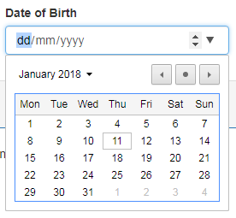
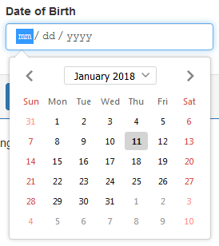
if we run the project and navigate to http://localhost:4200/create in Google chrome, we see the date-picker as shown below.
Now, if we navigate to the same url in firefox, we see a date-picker control that is very different from the date-picker control that is on Google chrome browser.

Slide 125
Dear Team
Please refer to the UI components section on the following page, to see the list of all third party UI components that we can use in Angular
https://angular.io/resources
Step 1 : Execute the following command to npm install ngx-bootstrap npm install ngx-bootstrap --save Step 2 : If you do not have Bootstrap installed, please install it using the following npm command. If you are following along we have already installed bootstrap in Part 1 of this Angular CRUD tutorial. So I am not going to execute this command again. npm install bootstrap@3 --save

Slide 126
Using ngx-bootstrap datepicker in Angular : The following are the steps to use ngx-bootstrap datepicker in Angular
Step 1 : In app.module.ts file, include the following import statement to import BsDatepickerModule
import { BsDatepickerModule } from 'ngx-bootstrap/datepicker';
Also, include BsDatepickerModule in the imports array of @NgModule decorator as shown below
@NgModule({
imports: [BsDatepickerModule.forRoot(),...]
})
Step 2 : In "create-employee.component.html" file, make the following 2 changes to the HTML that displays the "Date of Birth" field
Change the "type" attribute value from "date" to "text"
Include "bsDatepicker" directive on the input element
<div class="form-group">
<label for="dateOfBirth">Date of Birth</label>
<input id="dateOfBirth" name="dateOfBirth" [(ngModel)]="dateOfBirth"
type="text" bsDatepicker class="form-control" />
</div>

Slide 127
Angular base href
When setting up routing in an angular application, the first step is to set the base path using the base href element. The base path tells the angular router, how to compose the navigation URLs. The browser uses the <base href> value to prefix relative URLs when referencing CSS files, scripts, and images.
During development we usually set this to a single forward slash as shown below.
<base href="/">
This means all the URLs now will be relative to the root of the application. So when we navaigate to "/list", the path "/list" will be appended to root UR and the complete URL will be as shown below. Notice "/list" is relative to the root URL.
http://localhost:4200/list
Along the same lines, when we navigate to "/create", the complete URL is http://localhost:4200/create

Slide 128
When we deploy our application to a server, we typically deploy it to a sub folder on the server. For example, if we are deploying our application in a sub-folder called "emp", then we set the base href element to /emp/ as shown below. <base href="/emp/"> This means all the URLs now will be relative to the "emp" base path and will be as shown below. http://serverName/emp/list http://serverName/emp/create During development we usually set base href element to a single forward slash as shown below. <base href="/"> At this point, if we execute the following command, all the URLs will be relative to the root URL "http://localhost:4200" ng serve -o Also, on the "sources" tab in the browser developer tools, you will find all the Script, Images and Template files are relative to the root URL "http://localhost:4200" as shown in the image below.

Slide 129
During development, if you want a different base path other than "/", simply execute the "ng serve" command with --base-href option set to your desired base path as shown below.
ng serve -o --base-href /emp/
On your local development machine, if you set the base href element in index.html to "/emp/" instead of a single "/" and if you run ng serve -o command without the "base-href" option you will not see anything on the browser. When you open the browser developer tools, you will see the JavaScript bundle files failed to load. To fix this execute ng serve command along with the base href option as shown below.
ng serve -o --base-href /emp/

